Slide 1
Advanced Cache Optimizations

Slide 2
Basic Ideas
Reduce hit time, miss rate, and miss penalty
We have seen some optimizations
Increase cache bandwidth
Bandwidth improves faster than latency
Reduce miss rate/penalty via parallelism
Exploit parallelism
2.3 Advanced Cache Optimizations

Slide 3
Opt 1 – Small and Simple L1 Caches
Critical timing path in cache hit:
addressing tag memory, then
comparing tags, then
selecting correct block
Direct-mapped caches can overlap tag comparison and transmission of data
Lower associativity reduces power because fewer cache lines are accessed.
Higher associativity
Increases size of virtually indexed cache
Reduces conflict misses due to multithreading
2.3 Advanced Cache Optimizations

Slide 4
Opt 1 – L1 Size and Associativity
Access time increases as size & associativity increases
As size increases, associativity other than 8 leads to smaller differences in access time.
2.3 Advanced Cache Optimizations

Slide 5
Opt 1 – L1 Size and Associativity
Energy per read increases as size & associativity increases
2.3 Advanced Cache Optimizations
Notes:
- Increase associativity -> higher energy consumption
- Avoid 8-way associativity cache due to large jump in energy consumption
+ Higher associativity needed for larger L1 cache if virtually indexed physical tagger cache is used to avoid translation.
+ higher associativity -> reduced miss rate for multithreading

Slide 6
Opt 2 – Way Prediction
1
Data
Tags
2
3
Way prediction set them before tag comparison is done.
2.3 Advanced Cache Optimizations

Slide 7
Opt 2 – Way Prediction
tag
2-bit index
offset
1
2-bit
2
Way Predictor
2-bit
=
=
=
=
2
<<
=
data
3
match
if mis-match, the prediction is wrong
2.3 Advanced Cache Optimizations

Slide 8
Opt 2 – Way Prediction
Low order tag bits → prediction
Predicts the next block to be accessed – what locality?
Multiplexer could be set early to select the predicted block, only a single tag comparison
A mis-prediction results in checking the other blocks
Prediction accuracy could be:
> 90% for two-way
> 80% for four-way
I-cache has better accuracy than D-cache
First used on MIPS R10000 in mid-90s
Extend to decide which block to access using way selection
Intends to save power consumption.
Increases mis-prediction penalty
2.3 Advanced Cache Optimizations
Notes:
way prediction exploits both types of localities

Slide 9

Opt 2 – Way Prediction
Performance evaluation
HT1 : hit time when prediction is good
HT2 : hit time when prediction is wrong
MR : miss rate
MP : miss penalty
X : prediction accuracy
$$AMAT=(HT_{1}⋅X+\left(1−X\right)⋅HT_{2})+MR⋅MP$$
2.3 Advanced Cache Optimizations
Notes:
Alternative: HT1*X + (1-X)(t + MR*MP) # t: extra time to handle mis-prediction.

Slide 10
Opt 2 – Way Prediction Example
Miss rate = 0.1,
Miss penalty = 50 ns
HT = 3 ns without way prediction
HT1 = 2.5 ns when prediction is good
HT2 = 3.5 ns when prediction is wrong
Prediction accuracy X = 0.8
==============================================
AMAT_nw = 3 + 0.1*50 = 8 ns (no way prediction)
AMAT_W = (2.5*0.8 + 3.5*0.2) + 0.1*50 = 7.7 ns
Speedup = 8/7.7 = 1.05
Speedup on HT = 3/2.7 = 1.15
2.3 Advanced Cache Optimizations

Slide 11
Opt 3 – Pipelining Cache
Increase bandwidth
Pipeline cache access to improve bandwidth
Trend: shorter clock cycle, but hit time relative stable
Cache hit handled in multiple cycles
Examples – hit time in cycles
Pentium: 1 cycle
Pentium Pro – Pentium III: 2 cycles
Pentium 4 – Core i7: 4 cycles
Makes it easier to increase associativity
In associative cache, tag compare and data output are serialized
Increases branch mis-prediction penalty
Cache pipeline needs to be flushed in case of mis-prediction
2.3 Advanced Cache Optimizations

Slide 12
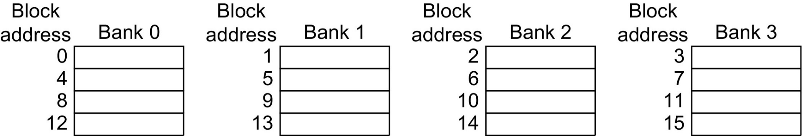
Opt 3 – Multibanked Caches
Organize cache as independent banks to support simultaneous access
ARM Cortex-A8 supports 1-4 banks for L2
Intel i7 supports 4 banks for L1 and 8 banks for L2
Interleave banks according to block address
Mapping to banks: bank index = block address mod #banks
Figure 2.10 Four-way interleaved cache banks using block addressing. Assuming 64 bytes per block, each of these addresses would be multiplied by 64 to get byte addressing.
2.3 Advanced Cache Optimizations
Notes:
bank # = index mod #banks eg. index = 10, #banks = 4, so bank # = 10 mod 4 = 2.

Slide 13
Opt 4 – Nonblocking Caches
Allow data cache to service hits during a miss
Reduces effective miss penalty
“Hit under miss”
Extended to “Hit under multiple miss”
L2 often support this
better
2.3 Advanced Cache Optimizations
Notes:
Evaluation of CPU performance becomes more complicated as the miss penalty is harder to compute for individual misses as misses and hits can overlap.
It also depends on the number of instructions CPU can execute before it must stall waiting for a previous miss to resolve.

Slide 14
Opt 5 – Critical Word First, Early Restart
Processor needs one word in a block
Critical word first
Request missed word from memory first
Send it to the processor as soon as it arrives
Early restart
Fetch the block in normal order
Send missed word to the processor as soon as it arrives
Effectiveness of these strategies depends on block size and likelihood of another access to the portion of the block that has not yet been fetched
More benefits if block size is larger
2.3 Advanced Cache Optimizations
Notes:
what cache performance factor does it optimize?

Slide 15
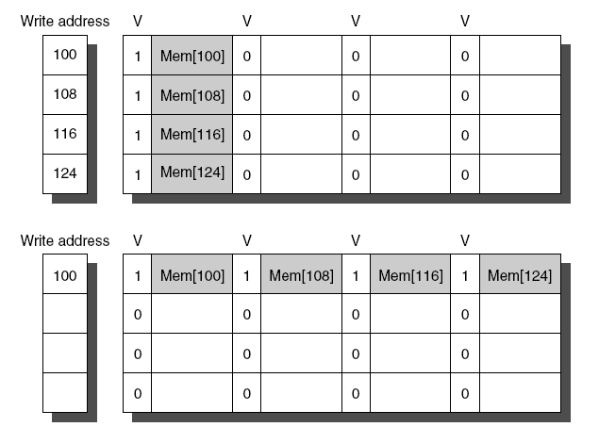
Opt 6 – Merging Write Buffer
When storing to a block that is already pending in the write buffer, update write buffer
Reduces stalls due to full write buffer
Do not apply to I/O addresses
w/o write merging
w write merging
2.3 Advanced Cache Optimizations
Notes:
Benefits of write-merging:
Wr-buffer can hold more writes – more efficient use of buffer space
reduce number of writes to lower-level – less time to write

Slide 16
Opt 7 – Compiler Optimizations
Gap between CPU and memory requires SW developer to look at memory hierarchy
0 | x[0][0]
1 | x[0][1]
... | …
15 | x[0][15]
16 | x[1][0]
… | …
/* before */
for (j=0; j < 16; j++)
for (i=0; i < 16; i++)
x[i][j] = 2*x[i][j];
2.3 Advanced Cache Optimizations
Notes:
Increasing perf. gap between proc. and mem requires SW developers to pay attention to mem hierarchy

Slide 17
Opt 7 – Compiler Optimizations
Loop Interchange
Swap nested loops to access memory in sequential order
Expose spatial locality
0 | x[0][0]
1 | x[0][1]
... | …
15 | x[0][15]
16 | x[1][0]
… | …
/* after*/
for (i=0; i < 16; i++)
for (j=0; j < 16; j++)
x[i][j] = 2*x[i][j];
2.3 Advanced Cache Optimizations
Notes:
Increasing perf. gap between proc. and mem requires SW developers to pay attention to mem hierarchy

Slide 18
Opt 7 – Compiler Optimizations
Blocking
Instead of accessing entire rows or columns, subdivide matrices into blocks
Requires more memory accesses but improves temporal locality of accesses
See the book for an example
2.3 Advanced Cache Optimizations
Notes:
Increasing perf. gap between proc. and mem requires SW developers to pay attention to mem hierarchy

Slide 19
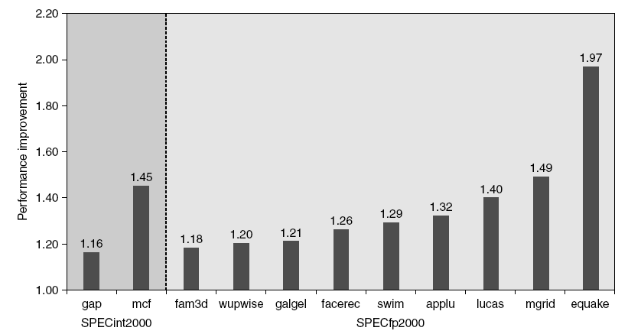
Opt 8 – Hardware Prefetching
Fetch two blocks on miss (include next sequential block)
Can hurt power if prefetched data are not used.
better
Some results obtained on Pentium 4 w. Pre-fetching
2.3 Advanced Cache Optimizations
Notes:
prefetched blocks are placed in stream buffer.
Prefetching improves performance by reducing miss penalty

Slide 20
Cache - Summary
A small and fast buffer between CPU and main memory
Direct mapped cache
shorter hit time, higher miss rate, lower power consumption
Associative cache
longer hit time, lower miss rate, higher power consumption
Performance evaluation
AMAT – average memory access time: maybe misleading
CPI with stall cycles due to cache misses: more accurate
Various optimization to improve performance
2.3 Advanced Cache Optimizations

Slide 21
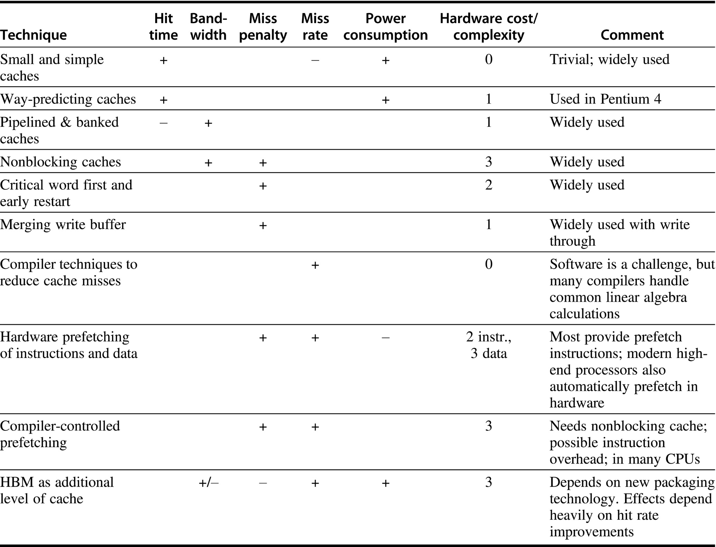

Slide 22
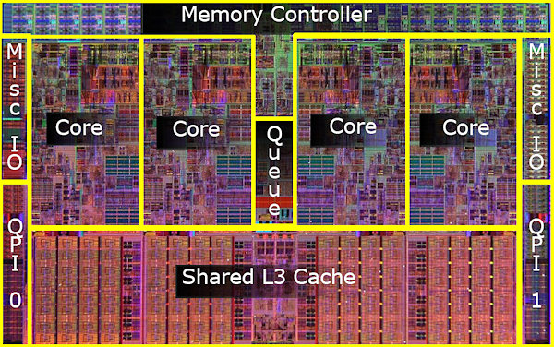
Example: Intel Core I7 Cache
L2
L1 I$ - 32 KB, L1 D$ - 32KB 8-way set associative, private
L2 – 256 KB, 8-way set associative, private
L3 – 8 MB, 16-way set associative, shared
Notes:
Pentium 4: 512 KB L2 cache, no L3.
High associativity in i7 is for multithreading, also pipelined cache reduces impact of high associativity

